Slide 2
Motivating Existing Franchisees
Nigel Dawson

Slide 3
Dyno Franchise 1963 - 2016
Dyno Founded by Jim Zockoll
Dyno vans change to Orange
1963
1991
2014
New Franchise model launched
2004
Dyno acquired by British Gas
Notes:
53 years
Talk through milestones
Great heritage but this also brings legacy issues

Slide 4
A network of two halves
Understand business
Financially stable
Good support network
Not financially hungry
Been there/know better
Don’t always adhere to proposition
Ageing network – succession planning
Ambitious
Hungry for growth
Tend to follow procedures and advice
Future of Dyno
Better engagement
Reduced knowledge of business
Financially committed
Peer network limited
Introduction of new tools to motivate and incentivise franchisees whilst encouraging the right behaviours
Demonstrate opportunities and reward franchisees who are exemplars
Sometimes its right to help franchisees to go and be successful elsewhere
Existing franchisees
New franchisees

Slide 5
Terms of Trade (ToT) – Primary Objectives
New Franchise Agreement
Contemporary
Simple
Fit for purpose
Increase Franchise Profitability
Without giving handouts
Improve Service Standards
Motivators to drive desired behaviours
Create an Environment for Growth
Scale & investment
Notes:
Change through consultation with the network

Slide 6
Terms of Trade (ToT) – The Challenge
New Franchise Agreement
Contemporary
Simple
Fit for purpose
Increase Franchise Profitability
Without giving handouts
Improve Service Standards
Motivators to drive desired behaviours
Create an Environment for Growth
Scale & Investment
Increase Franchise Profitability
Without giving handouts

Slide 7
ToT – Primary Objectives
ToT – Increasing Franchise Profitability
Increase Franchise Profitability
Without giving handouts
Dyno Profit
Franchise Profit

Slide 8
Financial Model Comparison
Original
Agreement
New
ToT
Pilot Scheme
Growth
Growth
Growth
5%
Existing
T/O
Existing
T/O
Existing
T/O
Territory Fee
Royalty
Av.
21.6%
MSF 7.5%
Can
Reduce
to 5%
Royalty
Av.
21.6%

Slide 9
Driving Profitability (actual case study)
MSF
TF
Under the new scheme 92.5% of new revenue is retained by the franchisee
Royalty
Previously around 78.4% was retained
Turnover
Turnover
Previous
ToT
22% Net Profit
(additional operating costs not factored)
Previous
ToT
Profit growing at 3x rate of turnover
7% Net Profit

Slide 10
ToT – Behaviours and Performance
MSF 7.5%
Increase Franchise Profitability
Without giving handouts
Create an Environment for Growth
Scale & Investment
Improve Service Standards
Motivators to drive desired behaviours
Reduction in overall MSF for exemplars
(operates on a league basis)
MSF 5%
High growth quartile
No breaches of the agreement
Minimum standards maintained

Slide 11
The Results
 |  | ToT |  | 2015 | 2016 (annualised)
Qualifying turnover |  | £25,811,232 |  | £28,307,717 | £29,054,742
increase on ToT |  |  |  | 10% | 13%
Overall
revenue increased by £3.25m
Dyno contribution increased
£162k
Franchises gained an extra
£3.1m
Average growth p.a.
12%

Slide 12
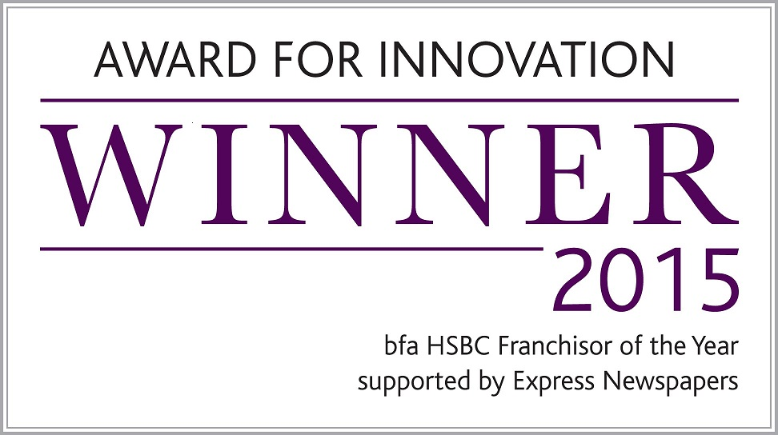
Summary
ToT
Rewards growth by increasing profitability and equity
ToT
Rewards franchisees that follow the system through the 2.5% rebate scheme
ToT
Improves network engagement and our working relationship
ToT
Improves customer service levels (NPS score)
ToT
Separates those franchisees who are “on the bus” from those who are not
Understand business
Financially stable
Good support network
Not financially hungry
Been there/know better
Don’t always adhere to proposition
Ageing network – succession planning
Ambitious
Hungry for growth
Tend to follow procedures and advice
Future of Dyno
Better engagement
Reduced knowledge of business
Financially committed
Peer network limited
Existing franchisees
New franchisees
Setting the right terms enables you
to re contract your franchisees

